Slide 1
DBMS SQL-Join

Slide 2
A SQL Join statement is used to combine data or rows from two or more tables based on a common field between them.

Slide 3
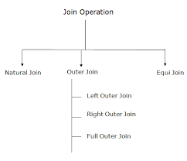

Slide 4
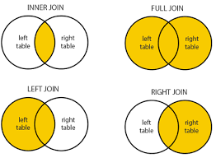

Slide 5
INNER JOIN
The INNER JOIN keyword selects all rows from both the tables as long as the condition satisfies.
This keyword will create the result-set by combining all rows from both the tables where the condition satisfies i.e value of the common field will be same.

Slide 6
Syntax
SELECT table1.column1, table1.column2, table2.column1,....
FROM table1 INNER JOIN table2
ON
table1.matching_column = table2.matching_column;
table1: First table.
table2: Second table
matching_column: Column common to both the tables.

Slide 7
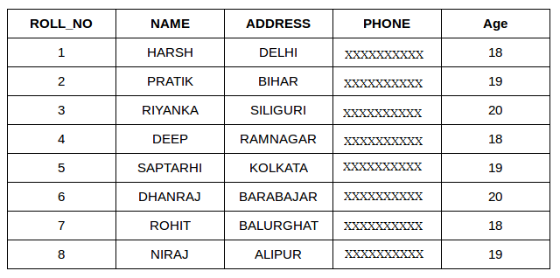
Student

Slide 8
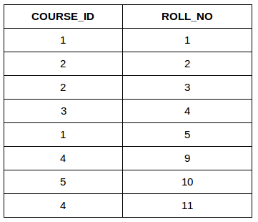
StudentCourse

Slide 9
SELECT StudentCourse.COURSE_ID, Student.NAME, Student.AGE FROM Student INNER JOIN StudentCourse
ON
Student.ROLL_NO = StudentCourse.ROLL_NO;

Slide 10
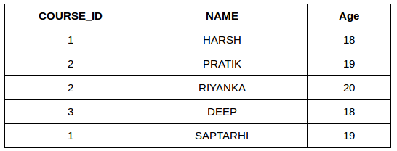
OUTPUT:

Slide 11
LEFT JOIN
This join returns all the rows of the table on the left side of the join and matching rows for the table on the right side of join.
The rows for which there is no matching row on right side, the result-set will contain null.
LEFT JOIN is also known as LEFT OUTER JOIN.

Slide 12
Syntax:
SELECT table1.column1, table1.column2, table2.column1,....
FROM table1 LEFT JOIN table2
ON
table1.matching_column = table2.matching_column;
table1: First table.
table2: Second table
matching_column: Column common to both the tables.

Slide 13
EG:
SELECT Student.NAME, StudentCourse.COURSE_ID
FROM Student LEFT JOIN StudentCourse
ON
StudentCourse.ROLL_NO = Student.ROLL_NO;

Slide 14
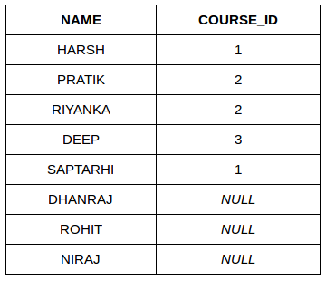

Slide 15
RIGHT JOIN:
RIGHT JOIN is similar to LEFT JOIN. This join returns all the rows of the table on the right side of the join and matching rows for the table on the left side of join.
The rows for which there is no matching row on left side, the result-set will contain null. RIGHT JOIN is also known as RIGHT OUTER JOIN.

Slide 16
SELECT table1.column1,table1.column2,table2.column1,....
FROM table1 RIGHT JOIN table2
ON
table1.matching_column = table2.matching_column;
table1: First table.
table2: Second table
matching_column: Column common to both the tables.

Slide 17
SELECT Student.NAME,StudentCourse.COURSE_ID
FROM Student RIGHT JOIN StudentCourse
ON
StudentCourse.ROLL_NO = Student.ROLL_NO;

Slide 18
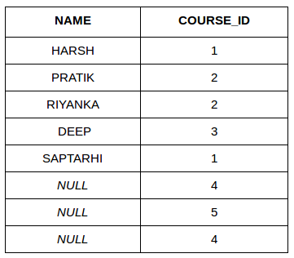

Slide 19
FULL JOIN
FULL JOIN creates the result-set by combining result of both LEFT JOIN and RIGHT JOIN.
The result-set will contain all the rows from both the tables.
The rows for which there is no matching, the result-set will contain NULL values

Slide 20
SELECT able1.column1,table1.column2,table2.column1,....
FROM table1 FULL JOIN table2
ON
table1.matching_column = table2.matching_column;
table1: First table.
table2: Second table
matching_column: Column common to both the tables.

Slide 21
SELECT Student.NAME,StudentCourse.COURSE_ID
FROM Student FULL JOIN StudentCourse
ON
StudentCourse.ROLL_NO = Student.ROLL_NO;

Slide 22
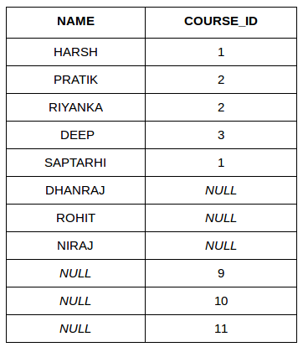

Slide 23
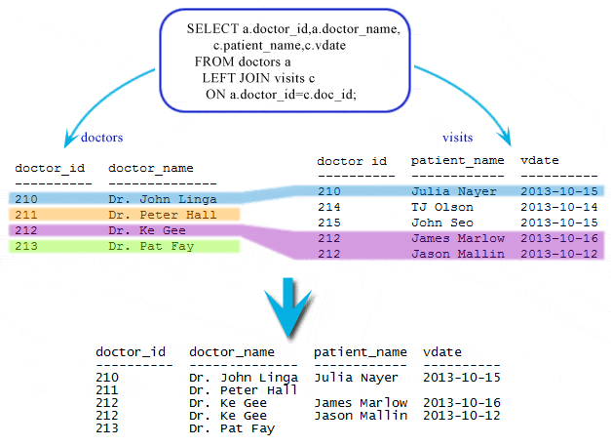

Slide 24
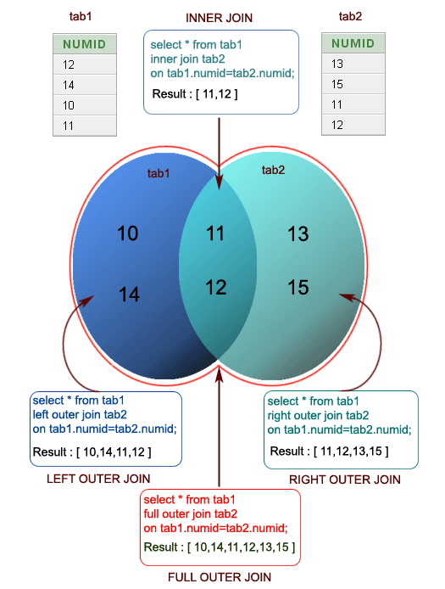

Slide 25
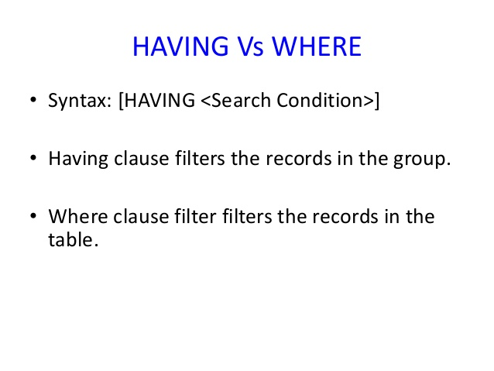

Slide 26
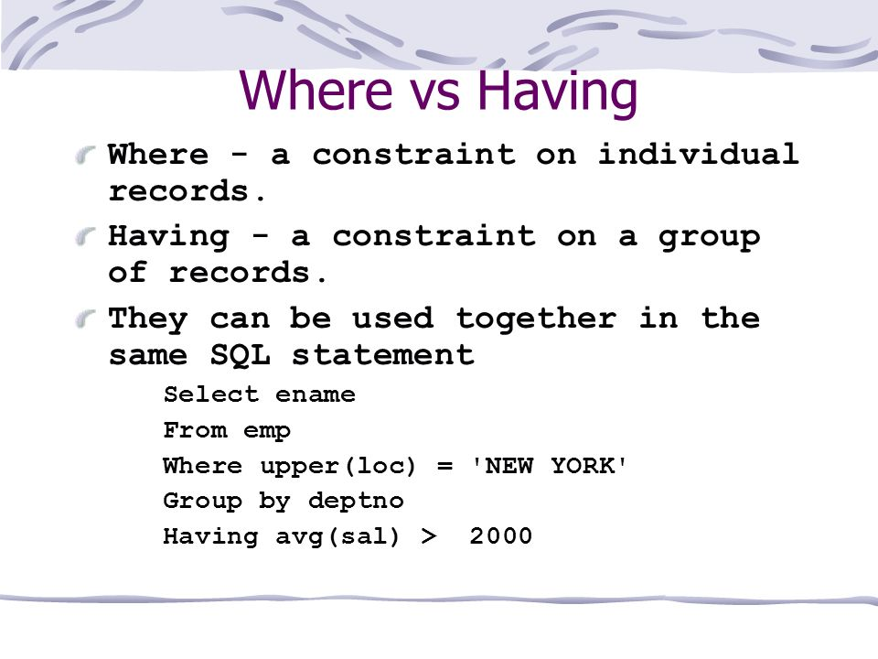

Slide 27
Thank you !

